Slide 1


Team Nature
THEME
Road Safety Solution

Slide 2




Meet Our Expert Team
Kushagra Saxena
Pratham Vaidya
Diksha Mehra
Deeksha Sharma
Team Leader
Full Stack Developer
Frontend Developer
Designer

Slide 3

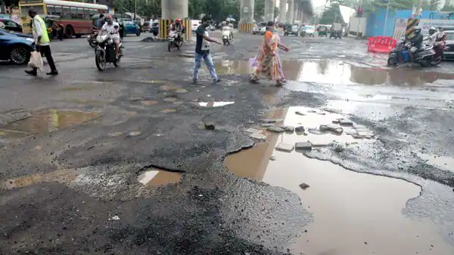
Ensuring road safety with view of accidents caused by potholes
Potholes in India are a big cause for the increasing number of road accidents.
The government said a total 4,775 and 3,564 accidents occurred in the years 2019 and 2020, respectively, due to potholes.
In 2021, nearly about 3,565 cases of road accidents were recorded due to potholes.

Slide 4
Detection of Potholes using GPS and Accelerometer
Alerting the user/driver regarding reported Potholes
Highlighting the oldest Potholes which are not yet filled to public through Hall of Shame
How to reduce these accidents?

Slide 5




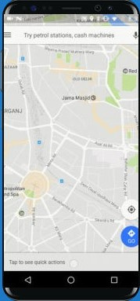
Flow Diagram
SERVER
SEND ACCELEROMETER POTHOLES DATA
REPORT POTHOLE
HALL OF SHAME
GET POTHOLE DATA

Slide 6

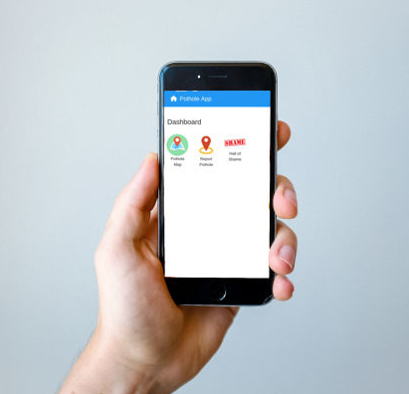
Prototype Mockup Screens
HOME SCREEN

Slide 7
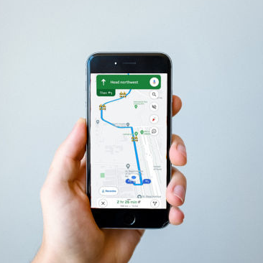
POTHOLE MAP

Slide 8
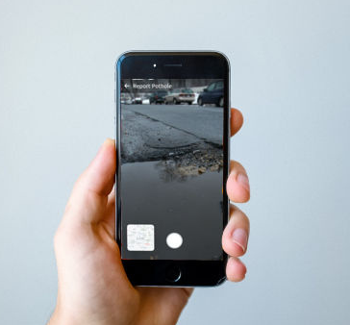
REPORT POTHOLE

Slide 9

HALL OF SHAME

Slide 10
THANK YOU

